Slide 1



eTwinning
ASTRO-STEM Project
Ayşe Karabacak
Karaman Science and Art Center

Slide 2


What is eTwinning?
eTwinning is the internet-based community of schools in Europe.
The eTwinning Project is funded with support from the European Commission.

Slide 3


When Did İt Start?
ETwinning, launched in 2005 as the main action of the European Commission's e-learning Program,
Since 2014, it has been tightly integrated into Erasmus +, the EU Education, Training, Youth and Sports program.

Slide 4


How is eTwinning Managed?
The Central Support Service is managed by the European Schoolnet, which is the international collaboration of 34 European Ministries of Education that improve education for schools, teachers and students in Europe.

Slide 5

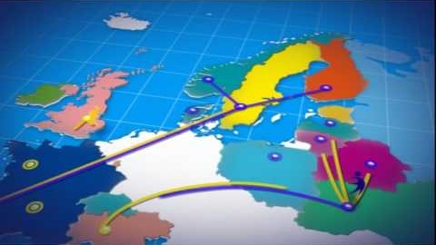
Which Countries Are Included in This System?

Slide 6
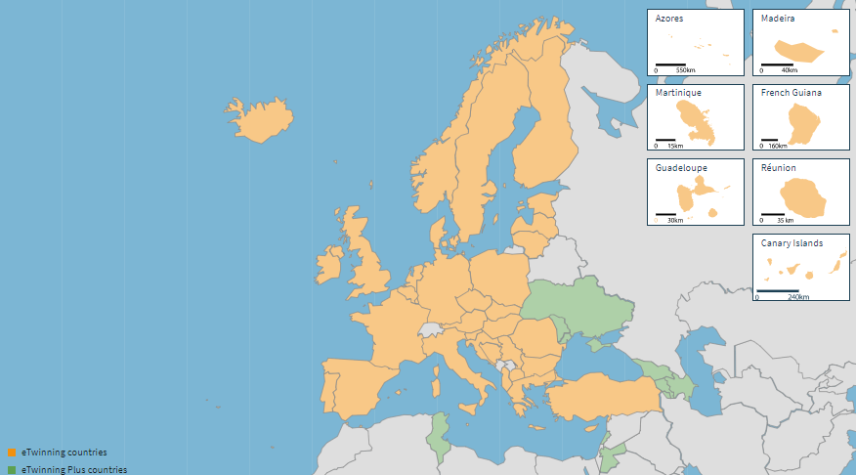
Which Countries Are Included in This System?
44 countries from Europe and beyond are included in the system.

Slide 7

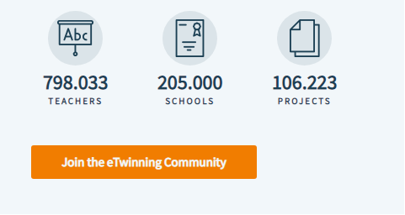
How many people are we in the eTwinning system?
We are among them;
ASTRO-STEM ☺

Slide 8

Who Can Use eTwinning?
It provides a platform for staff (teachers, principals, librarians, etc.) working in one of the participating schools in European countries.
Preschool, primary, secondary and high school schools can all participate (students age range 3-19).
Teachers from all branches can participate.

Slide 9

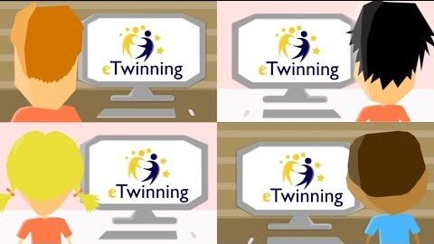
What can be done with eTwinning?

Slide 10
What Does eTwinning Bring To Us?
cooperation in education,
awareness of new technologies,
sharing training materials,
21st century skills,
using web 2.0 tools in their classes,
recognition of cultural awareness,
communication in education,
gives qualifications such as the development of pedagogies.

Slide 11


What can be done with eTwinning?
Can communicate with schools in Europe,
You can improve yourself with distance learning over the internet with learning activities,
You can produce online projects and partner with other projects

Slide 12


What can be done with eTwinning?

Slide 13

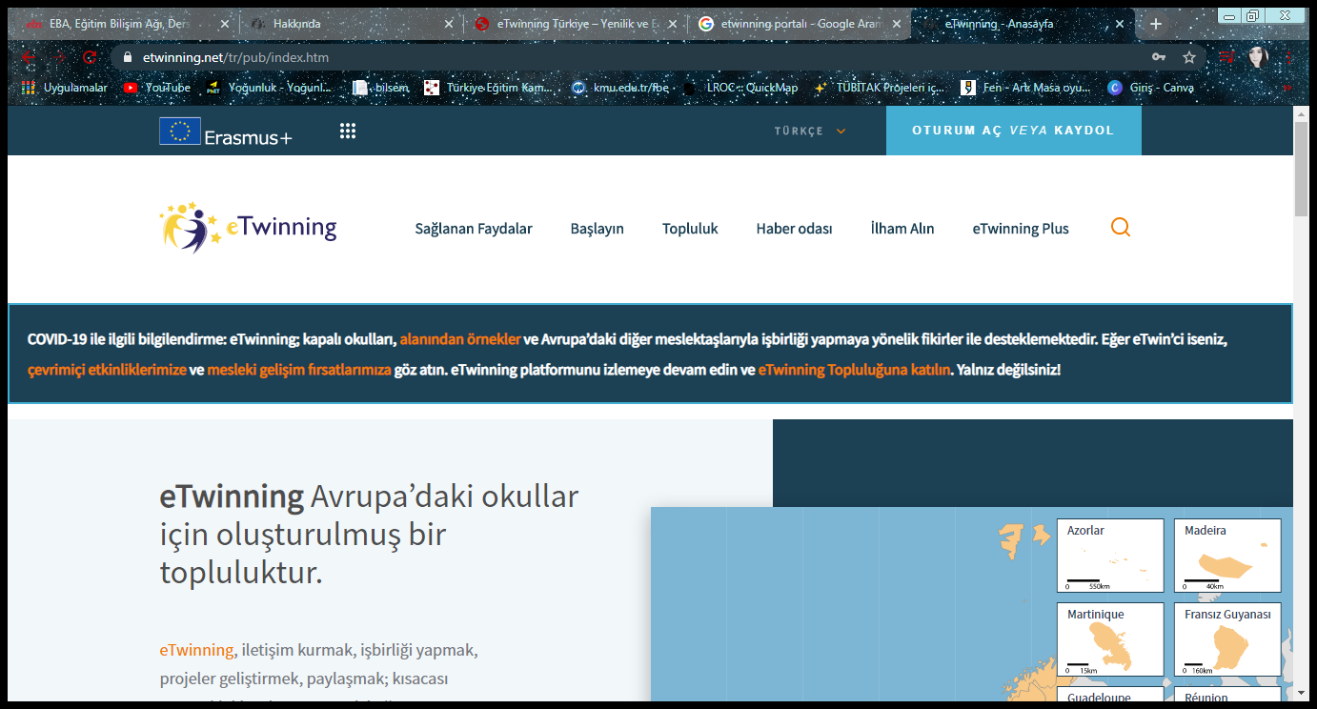
eTwinning Portal
It is the entry point to the world of eTwinning.
In eTwinning.net, which is available in 28 languages; News from eTwinning countries, professional development opportunities, information about recognition, as well as examples of successful projects.

Slide 14

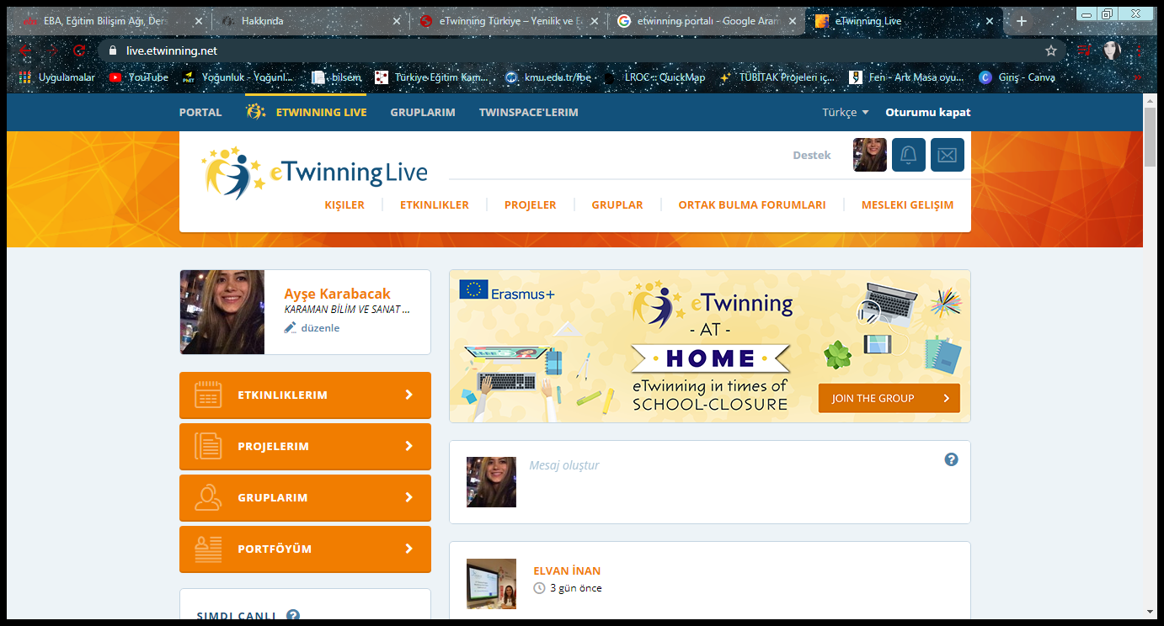
eTwinning Live
This is where teachers experience the eTwinning community to its full potential.
Teachers can search, connect with, and track their activities on other registered eTwinners and schools.

Slide 15
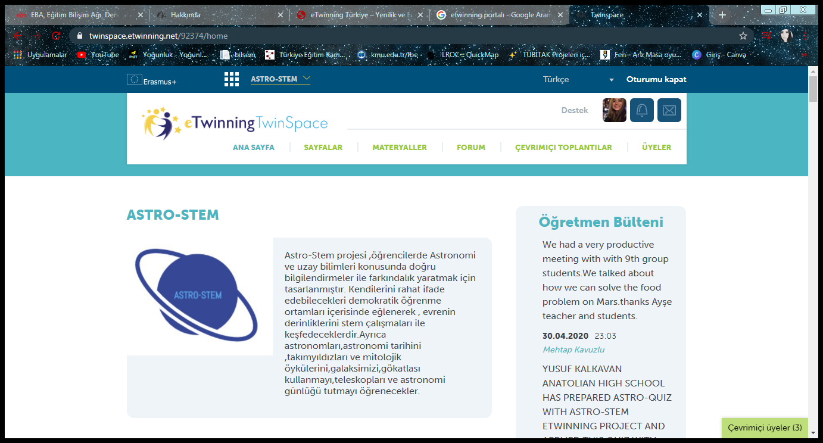
TwinSpace
TwinSpace is where the magic of eTwinning happens exactly.
It is a reliable platform that only teachers who have participated in a project can see.

Slide 16
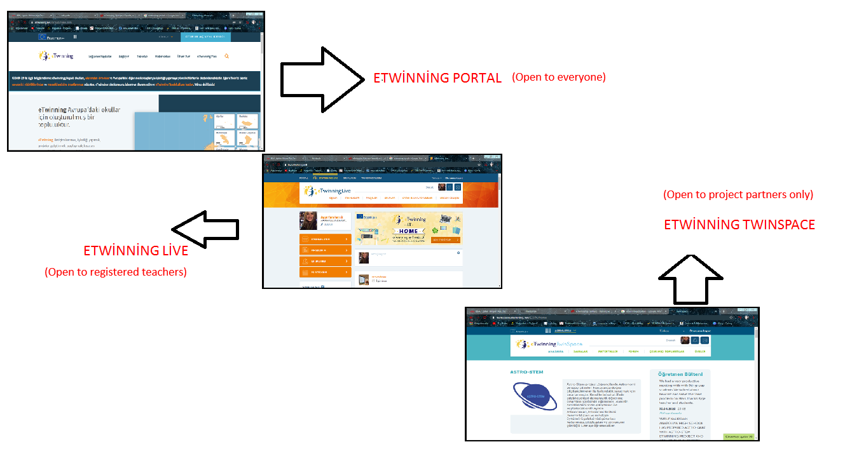

Slide 17


What is eTwinning Day?
It is celebrated every year as "European eTwinning Day" on 9 May.

Slide 18

Recognition in eTwinning
All the work devoted to eTwinning teachers and students are rewarded in various ways or increased visibility.
One of them is the National Quality Label awarded to projects that have achieved a certain quality at national level and have reached certain criteria.

Slide 19
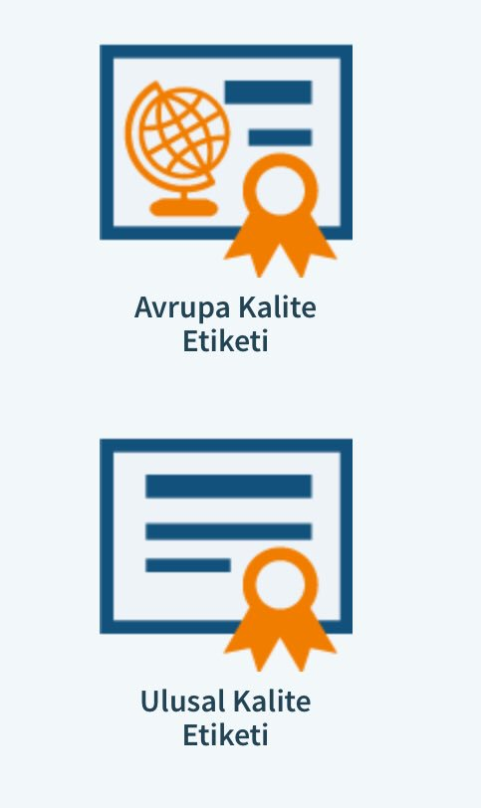
Quality Labels
These are the awards given to the projects with the criteria specified in eTwinning projects.
Quality labels consist of the National Quality Label (NQL) and the European Quality Label (EQL).

Slide 20

National Quality Label
The National Quality Label is awarded to projects where the activities of teachers and students are found to be sufficient at the national level.
Projects determined with partners and created for common purposes, with sufficient use of IT tools, with visible project results, and carried out in collaboration with communication, are awarded with the National Quality Label.

Slide 21

European Quality Label
European projects that receive the National Quality Label can be nominated for the European Quality Label.
In order to obtain a European Quality Label, at least two partners must have received the National Quality Label before.
The European Quality Label is issued once a year.
You must have a European Quality Label for the eTwinning European Awards.

Slide 22
Other Awards
European eTwinning Awards
Special Category Awards
* Yunus Emre Humanism and Intercultural Understanding Award
* Spanish Language Award
* French Language Award
* Marie Skłodowska Curie Award
* English Language Award
* Mediterranean Award
* “Peyo Yavorov” Award
* Citizenship Award

Slide 23

eTwinning School
eTwinning rewards successful work in several ways.
These rewards are;
to make all the activities in the school visible in 2017 while it was aimed at the projects and teachers in previous periods,
launched the eTwinning School initiative to increase school collaboration and participation.

Slide 24
What is required to become an eTwinning School?
The school has been registered in the eTwinning Portal for at least two years (the registration date of the school in the eTwinning system is taken as a criterion),
At least two of the school teachers are active eTwinning teachers during the application,
The school has a European eTwinning project with a National Quality Label. (In the last two years from the date of application)

Slide 25

What Are The Rules That All Etwinners Should Follow?
Abuse of the internal messaging system
Using eTwinning for commercial purposes
Spam in the forums
Irrelevant or inappropriate comments
Random communication requests and project invitations
Event invitation

Slide 26
What Are The Rules That All Etwinners Should Follow?
7. Direct threats, bullying and harassment
8. Intellectual property
9. Impersonation
10. Students (minors)
11. Private information and Sensitive data

Slide 27








Web2 tools

Slide 28
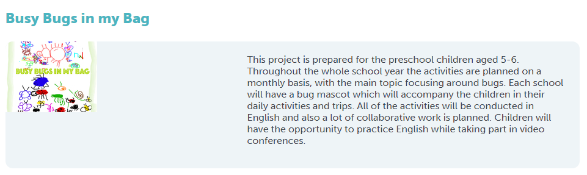

Projects Awarded with European Prize in 2020

Slide 29
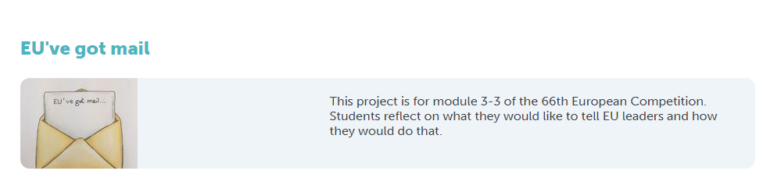
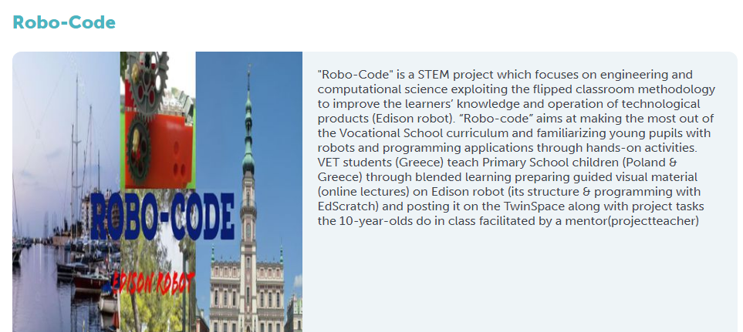

Slide 30

2020 eTwinning Award ceremonies

Slide 31
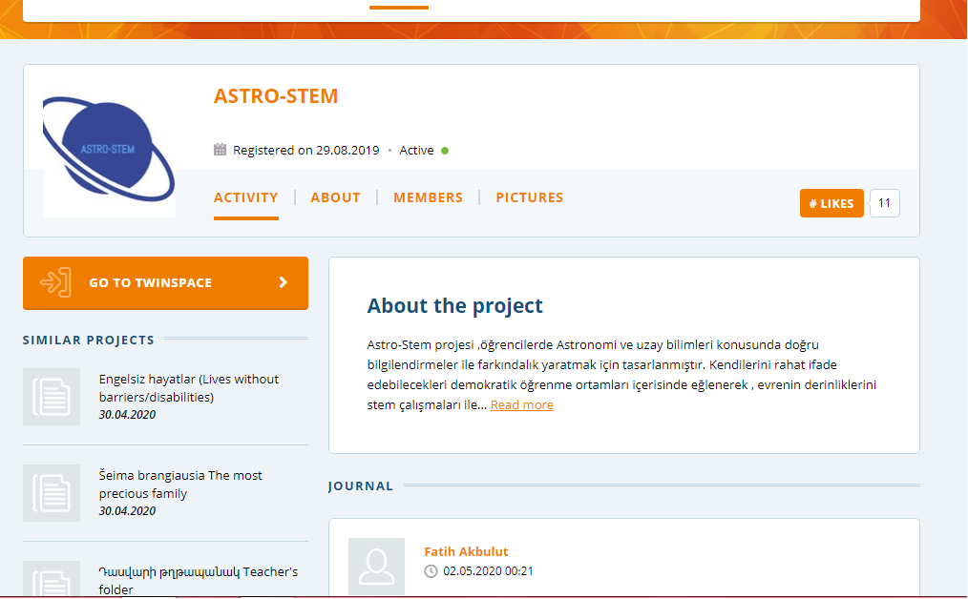



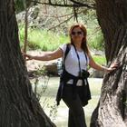
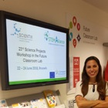
2020 eTwinning Award ceremonies
In the eTwinning Awards competition supported by the European Commission, in 2020, the eTwinning project "ASTRO-STEM", which was carried out in coordination with Erdemli Borsa Istanbul Science High School and Bandırma Science and Art Center, came first.
WHY NOT? ☺

Slide 32
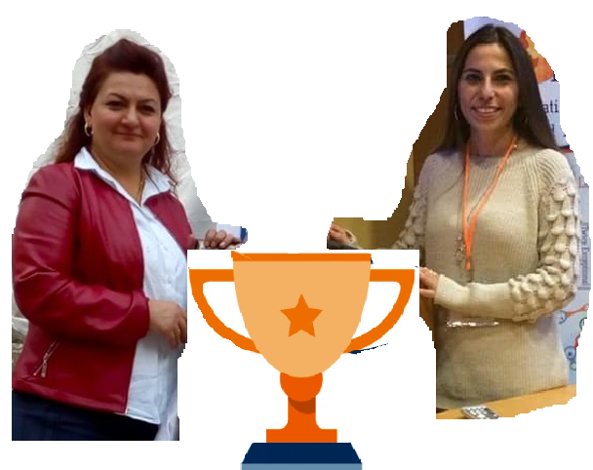
CONGRATULATIONS!!!! ☺

Slide 33
Thank you to everyone…
Happy eTwinning Day

